Slide 1
quantum mechanical approach of atomic structure
The theories of atomic and molecular structure depend on quantum mechanics to describe
atoms and molecules in mathematical terms. Although the details of quantum mechanics require considerable mathematical sophistication, it is possible to understand the principles involved with only a moderate amount of mathematics.
In 1808, John Dalton published “A New System of Chemical Philosophy” which he proposed that:
Prehistory
Greek philosophers Democritus (460-370 BC) and Epicurus (341-270 BC) presented views of nature that included atoms, many hundreds of years passed before experimental studies could establish the quantitative relationships needed for a coherent atomic theory.
the ultimate particles of all homogeneous bodies are perfectly alike in weight, figure,
etc. In other words, every particle of water is like every other particle of water, every particle
of hydrogen is like every other particle of hydrogen, etc
Because of confusion about elemental molecules such as H₂ and
0₂, which he assumed to be monatomic H and 0 , he did not find the correct formula for
water.
Source Book:
Inorganic Chemistry by
James E. Huhee

Slide 2
quantum mechanical approach of atomic structure
Only a few years later, Avogadro used data from Gay-Lussac to argue that equal
volumes of gas at equal temperatures and pressures contain the same number of molecules, but uncertainties about the nature of sulfur, phosphorus, arsenic, and mercury vapors delayed acceptance of this idea.
Confusions
• Widespread confusion about atomic weights and molecular formulas contributed to the delay; in 1861
Kekul gave 19 different possible formulas for acetic acid!
In the 1850s, Cannizzaro revived the argument of Avogadro and argued that everyone should use the same set of atomic weights rather than the many different sets then being used.
At a meeting in Karlsruhe in 1860, he distributed a pamphlet describing his views.6 His proposal was eventually accepted, and a consistent set of atomic weights and formulas gradually evolved.
• In 1869, ~Mendeleev independently proposed periodic tables nearly like those used today, and from that time the development of atomic theory progressed rapidly.

Slide 3
Quantum mechanical approach of atomic structure
• Maxwell’s wave theory of light was relatively new in 1913
Newton's classical theory stood against all the tests still for more than 250 years without failure.
the possibility that it might be invalid for tiny particles, was unthinkable
Atoms were strange ten and still they are, physicists were unable to see how the Newton’s law
could be modified to suit the atomic explanations
What was required was to step back , away from particles in orbits, in order to replace rather than
Modify the classical law.
• Louis de Broglie took the bold step bold step

Slide 4
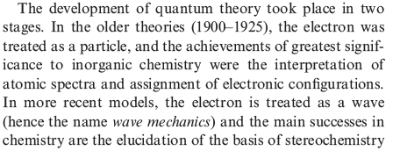
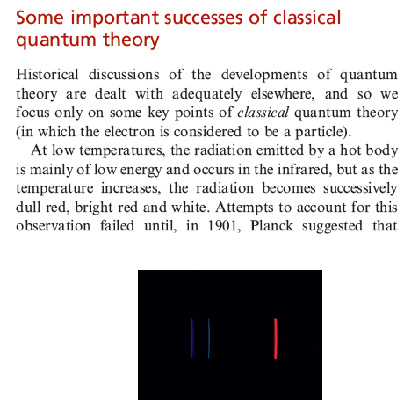

Slide 5
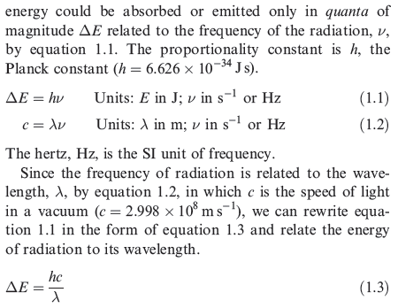

Slide 6
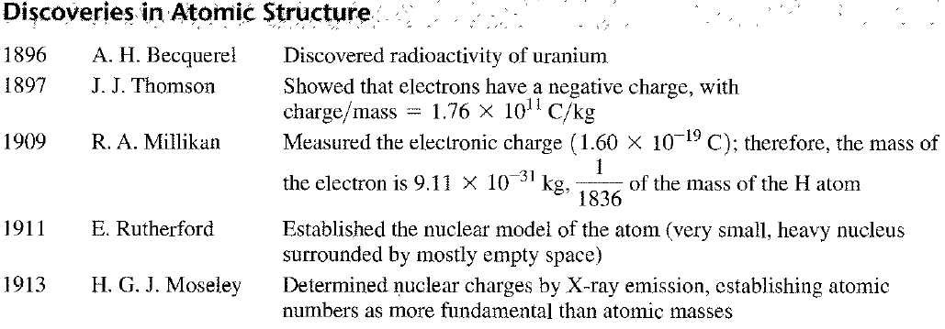
quantum mechanical approach of atomic structure
DISCOVERY OF SUBATOMIC PARTICLES AND THE BOHR ATOM
During the 50 years after the periodic tables of Mendeleev and Meyer were proposed

Slide 7
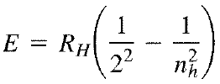
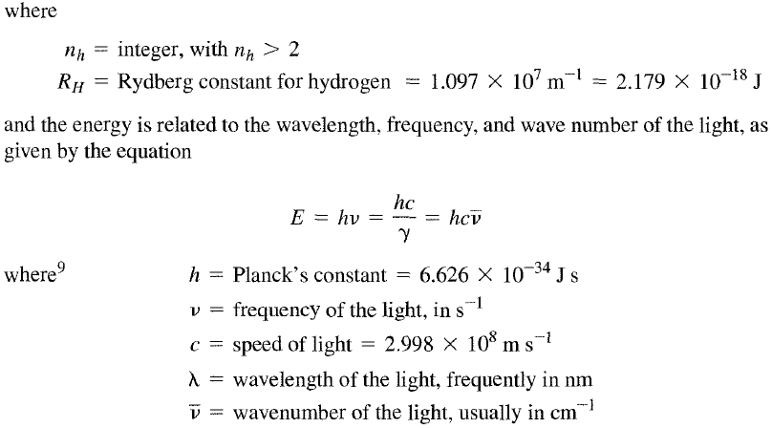
quantum mechanical approach of atomic structure
Parallel discoveries in atomic spectra showed that each element emits light of
specific energies when excited by an electric discharge or heat. In 1885, Balmer showed
that the energies of visible light emitted by the hydrogen atom are given by the equation

Slide 8
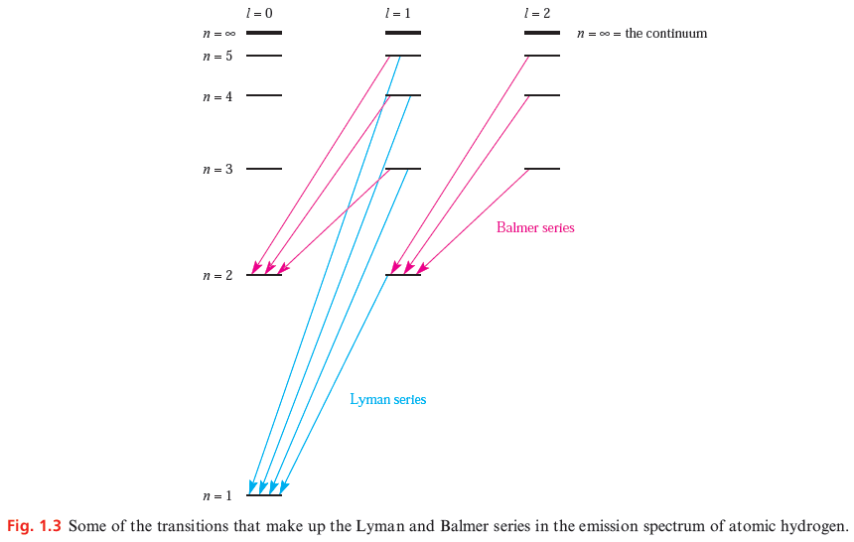
How is the atomic emission spectrum of hydrogen produced?
Emission Spectrum of Hydrogen. When an electric current is passed through a glass tube that contains hydrogen gas at low pressure the tube gives off blue light. When this light is passed through a prism (as shown in the figure below), four narrow bands of bright light are observed against a black background.
s
p
d
s
p
s

Slide 9
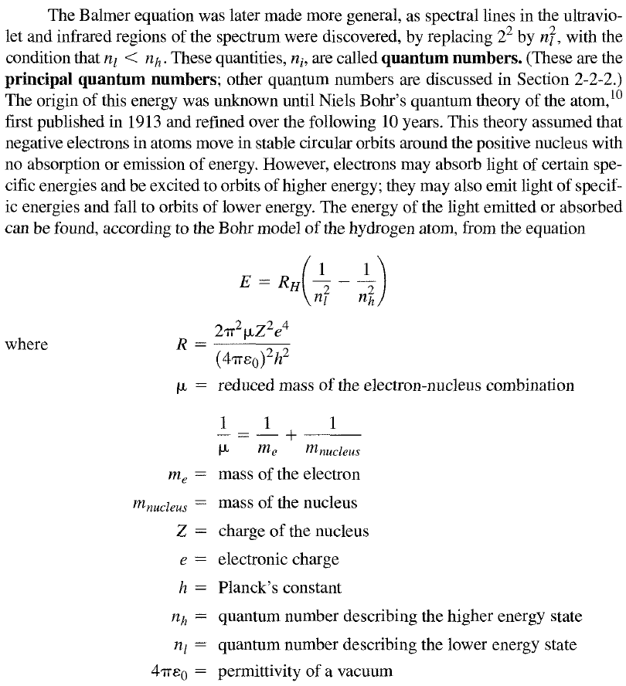
quantum mechanical approach of atomic structure
R_{H} = 1.097 x 10⁷ m⁻¹ = 2.179 x 10⁻¹⁸ J
h = 6.626 x 10⁻³⁴ Js

Slide 10
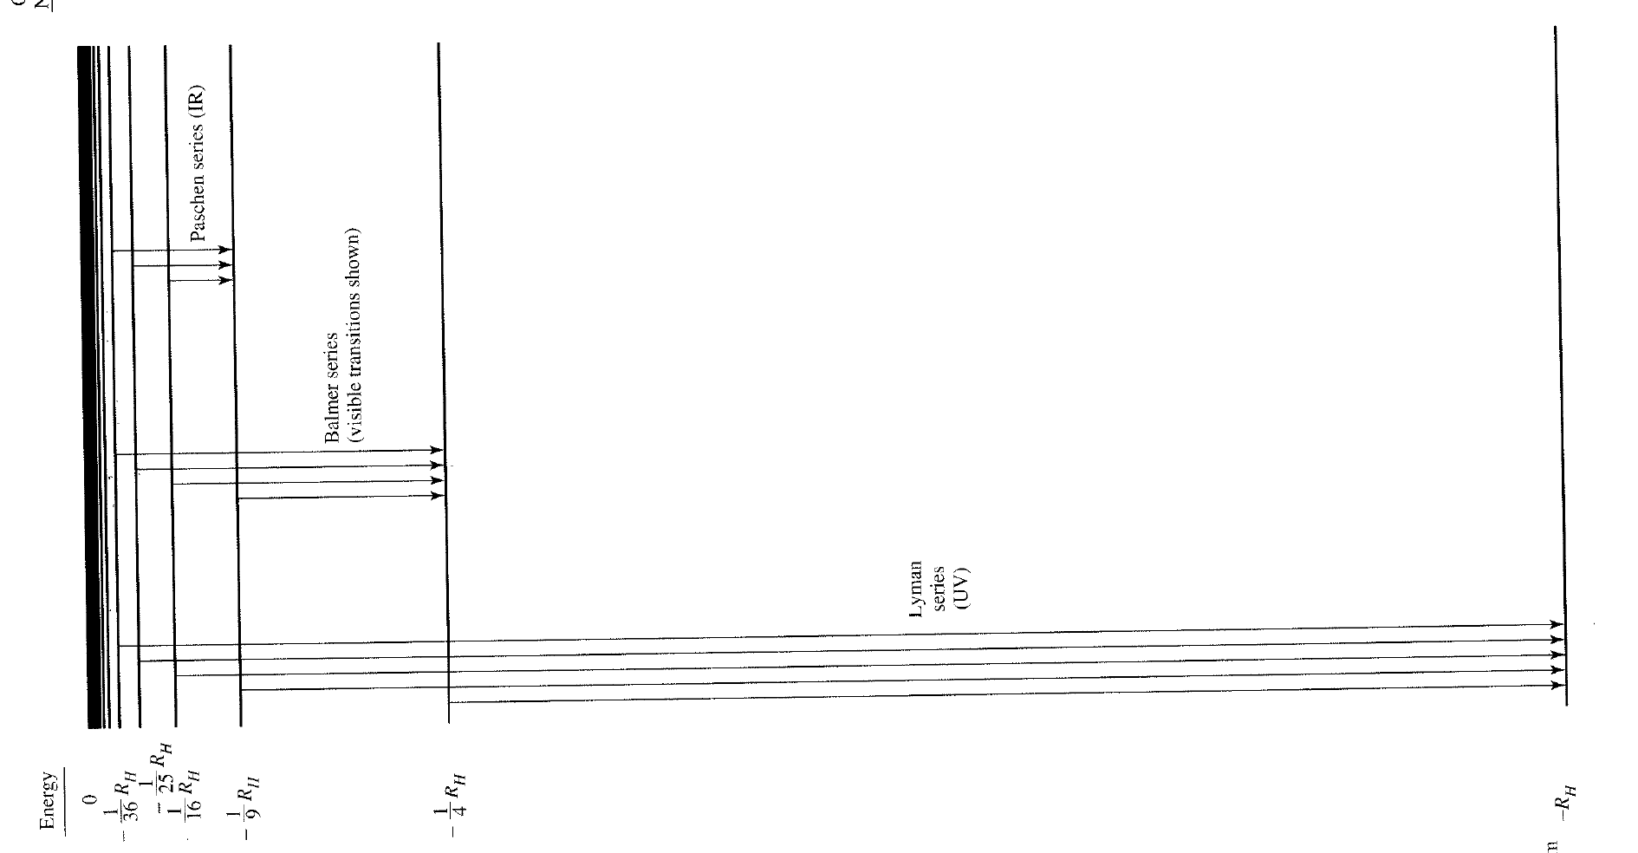
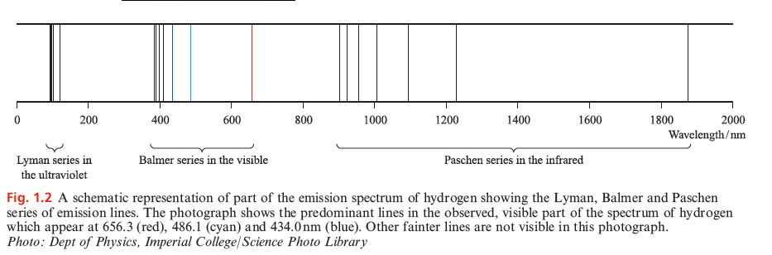
quantum mechanical approach of atomic structure

Slide 11
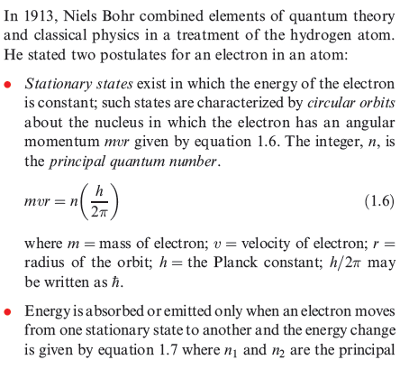


Slide 12
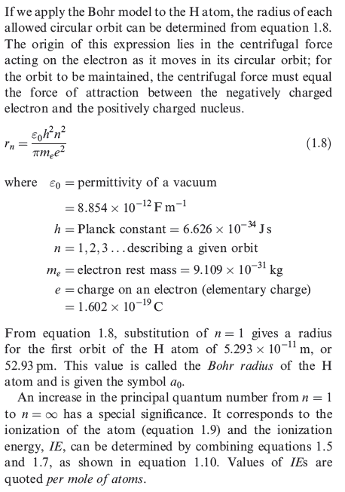
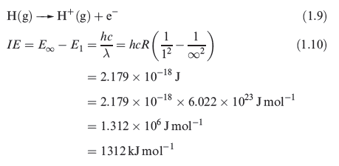

Slide 13
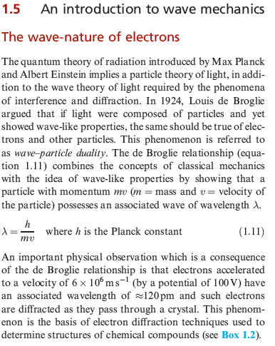

Slide 14
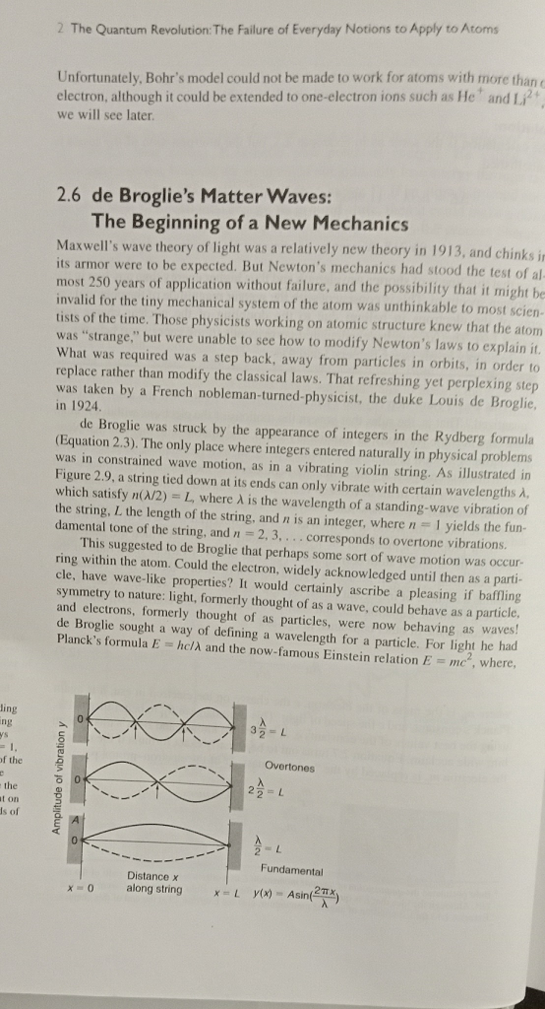

Slide 15
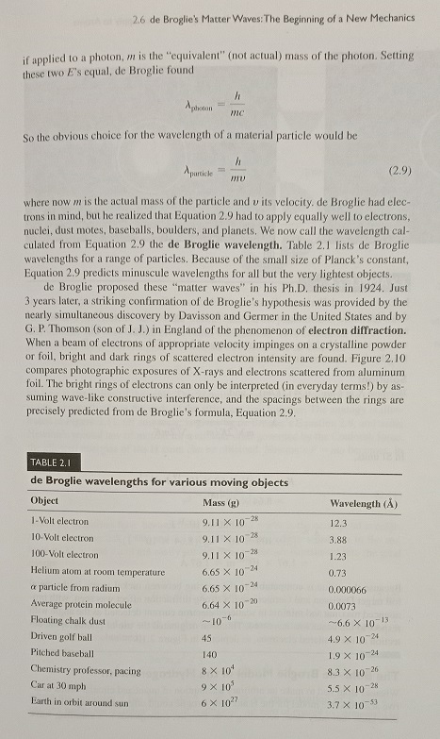

Slide 16
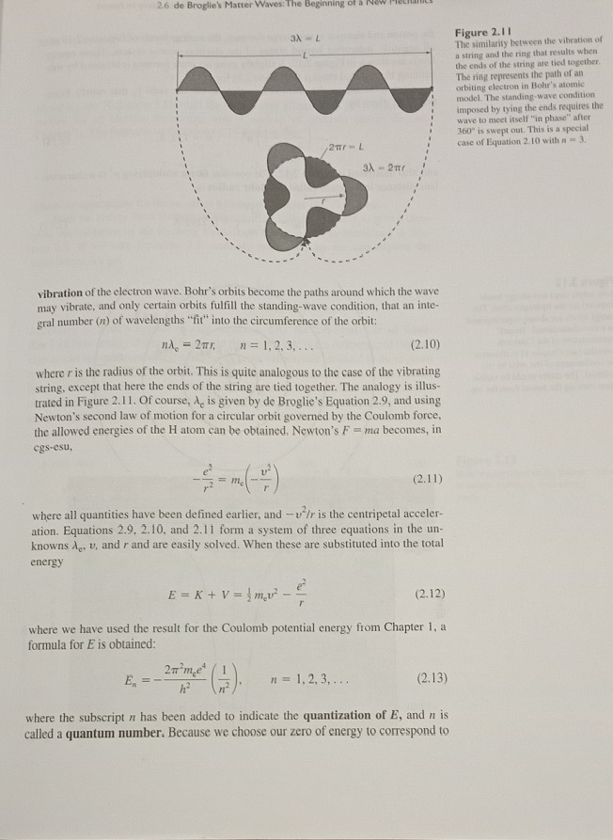

Slide 17
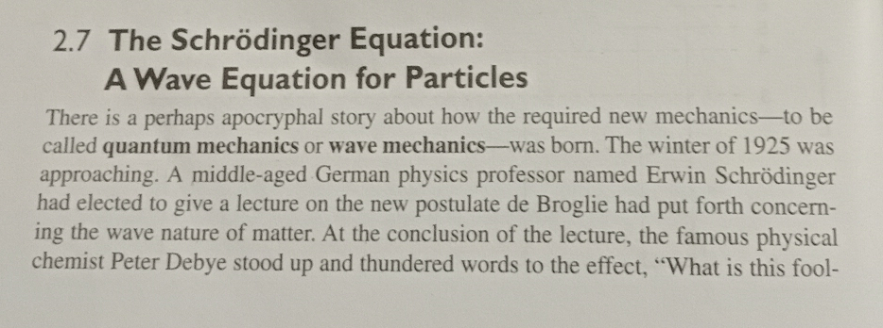

Slide 18
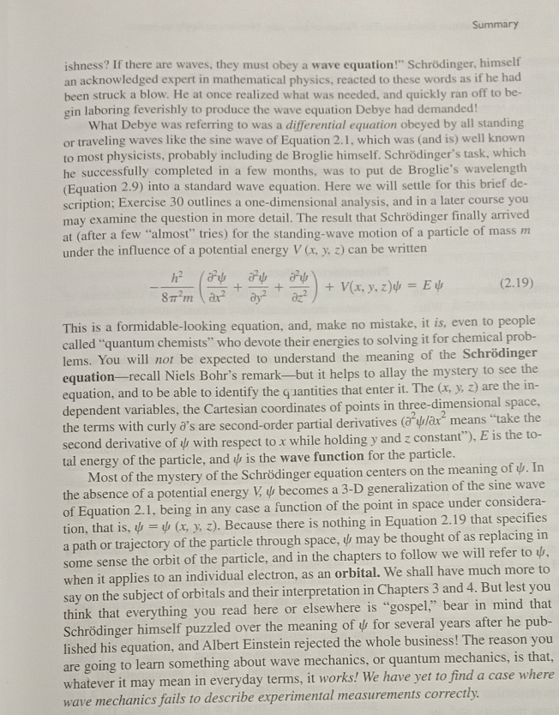

Slide 19
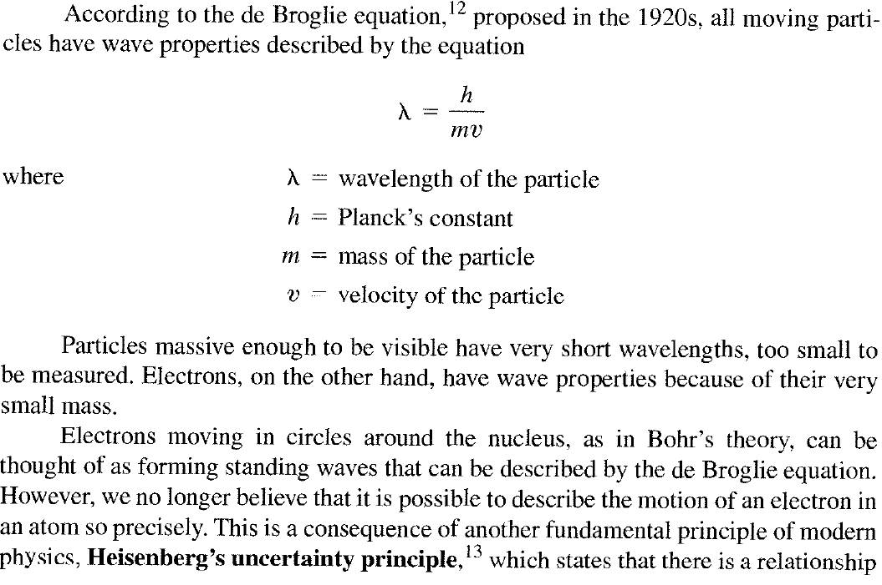
quantum mechanical approach of atomic structure

Slide 20
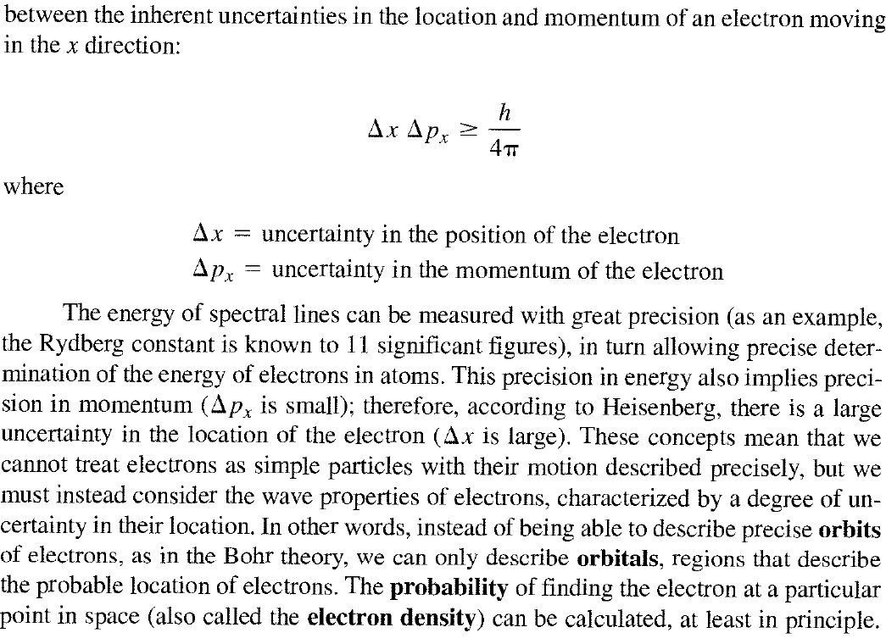
quantum mechanical approach of atomic structure

Slide 21
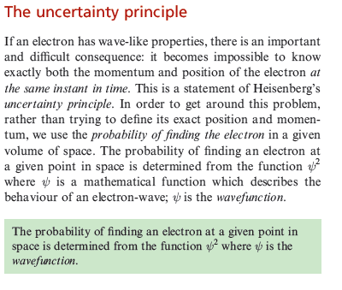

Slide 22
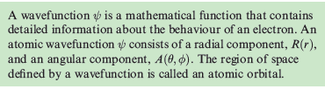
Definition of ψ

Slide 23
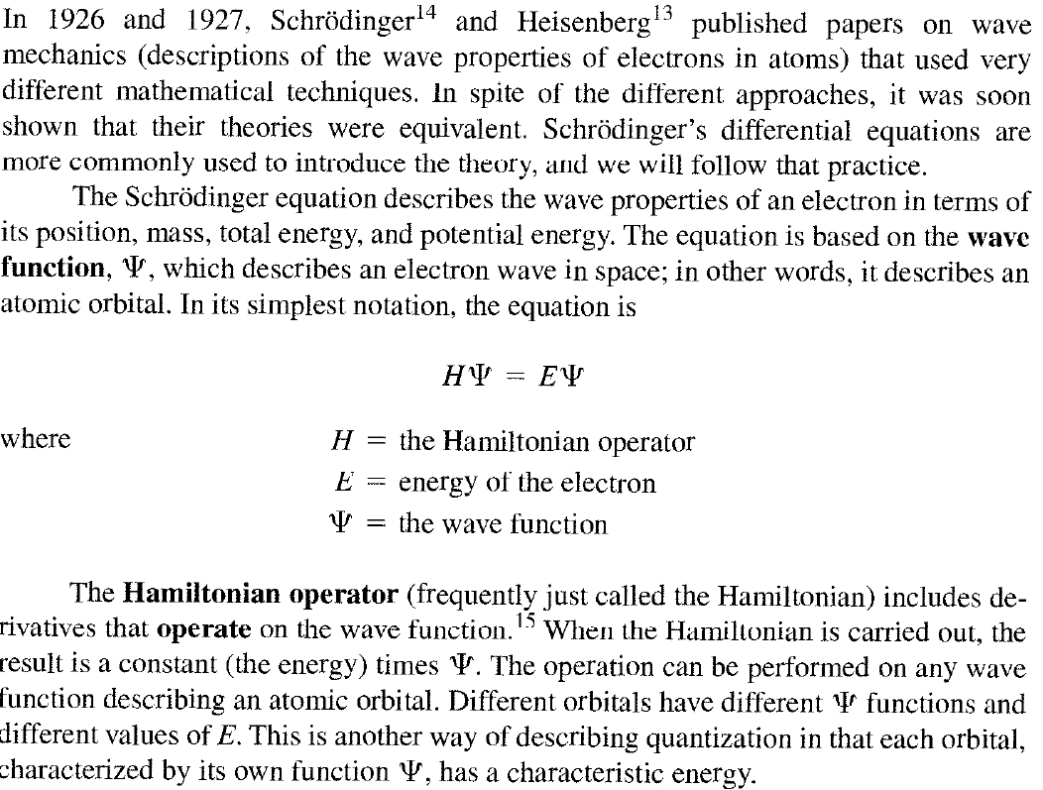
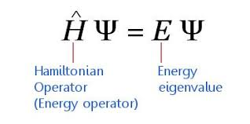
quantum mechanical approach of atomic structure

Slide 24
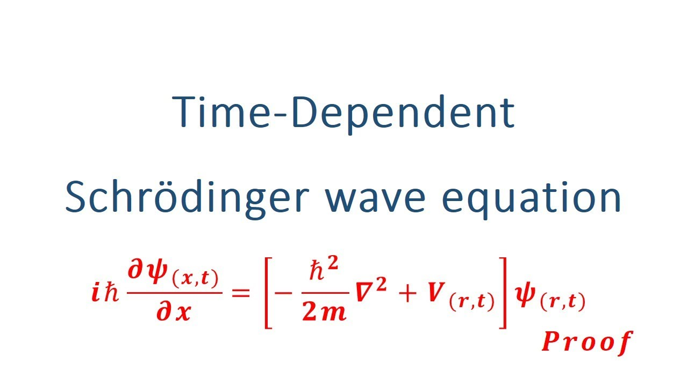

Slide 25
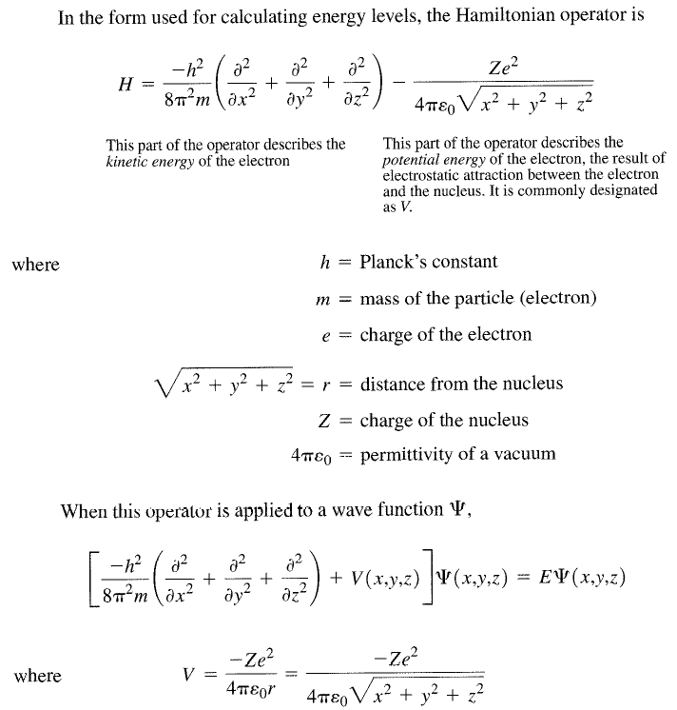
quantum mechanical approach of atomic structure

Slide 26
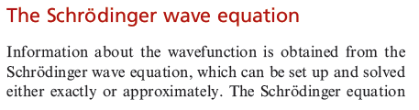
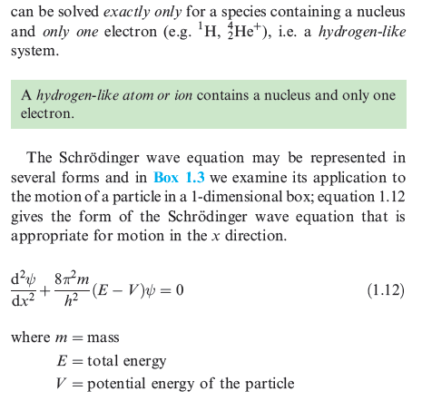
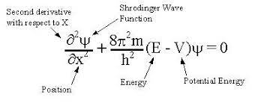

Slide 27
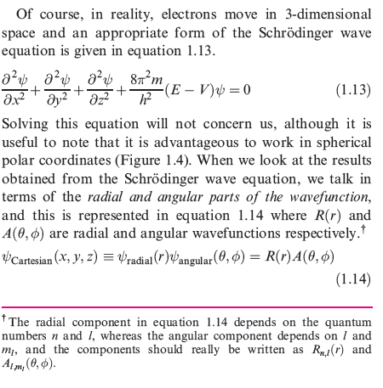

Slide 28
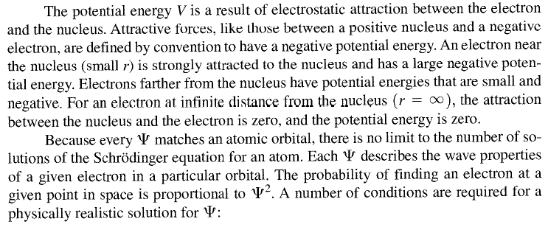
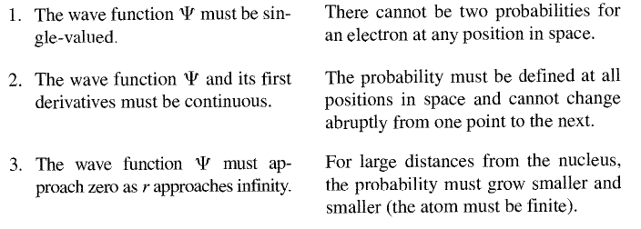
quantum mechanical approach of atomic structure

Slide 29
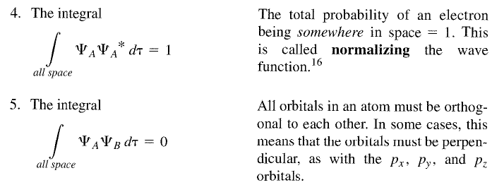
quantum mechanical approach of atomic structure

Slide 30
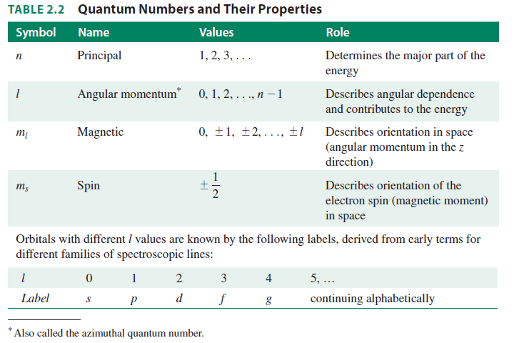
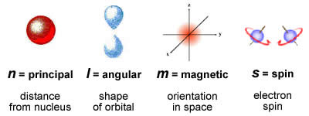
2.2.2 Quantum Numbers and Atomic Wave Functions
The particle-in-a-box example shows how a wave function operates in one dimension.
Mathematically, atomic orbitals are discrete solutions of the three-dimensional Schrödinger
equations. The same methods used for the one-dimensional box can be expanded to three
dimensions for atoms. These orbital equations include three quantum numbers, n , l , and ml.
A fourth quantum number, ms, a result of relativistic corrections to the Schrödinger equation,
completes the description by accounting for the magnetic moment of the electron. The
quantum numbers are summarized in Table 2.2 . Tables 2.3 and 2.4 describe wave functions.

Slide 31
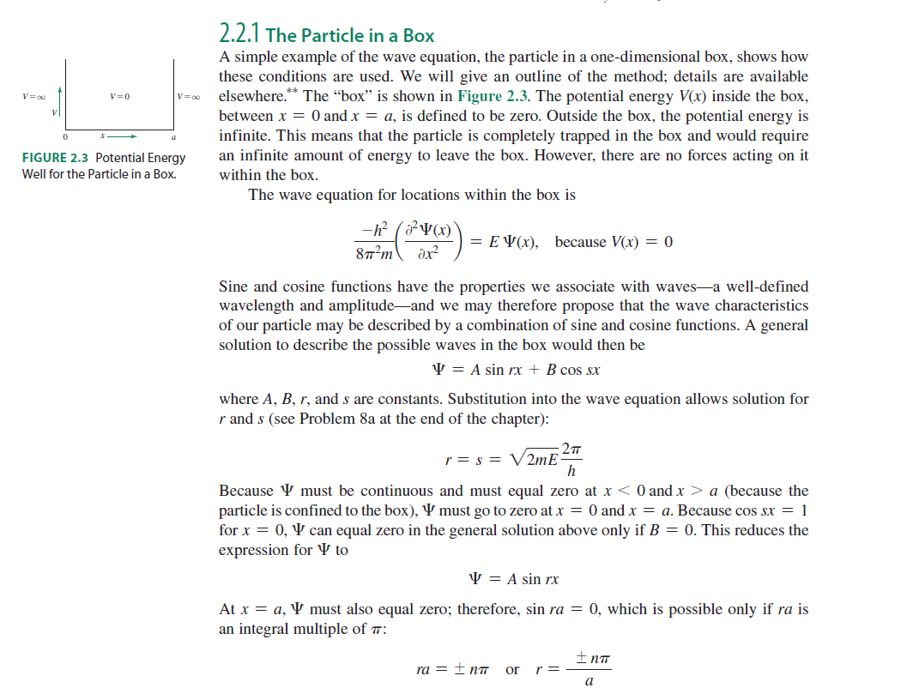

Slide 32
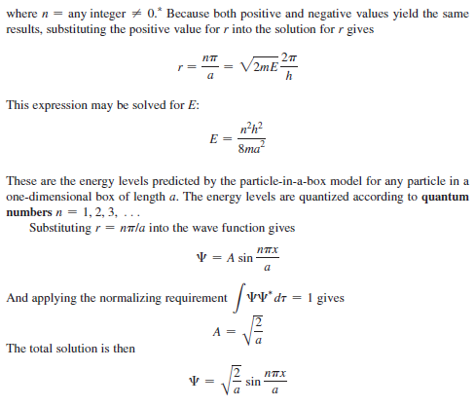

Slide 33
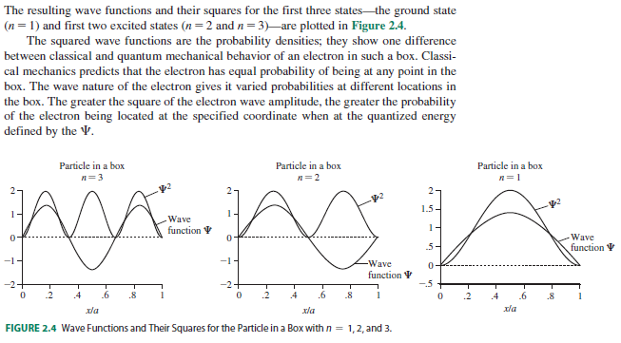

Slide 34
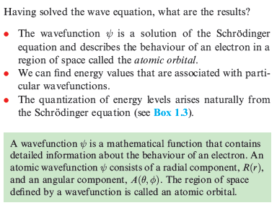

Slide 35
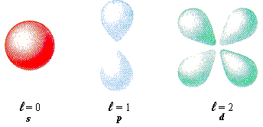
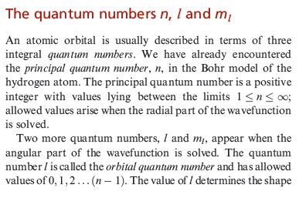


Slide 36
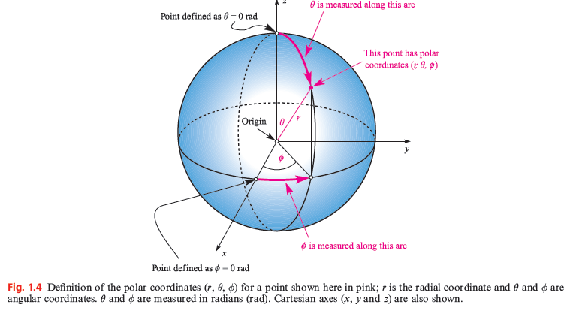

Slide 37
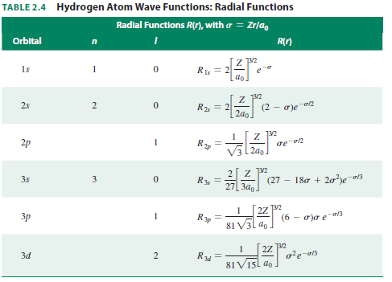
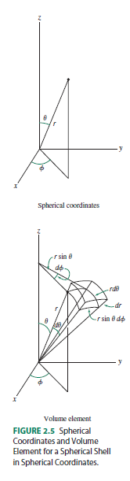

Slide 38
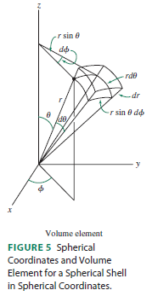
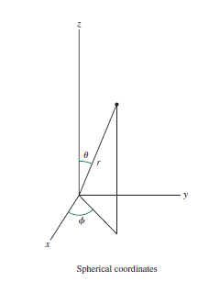

Slide 39
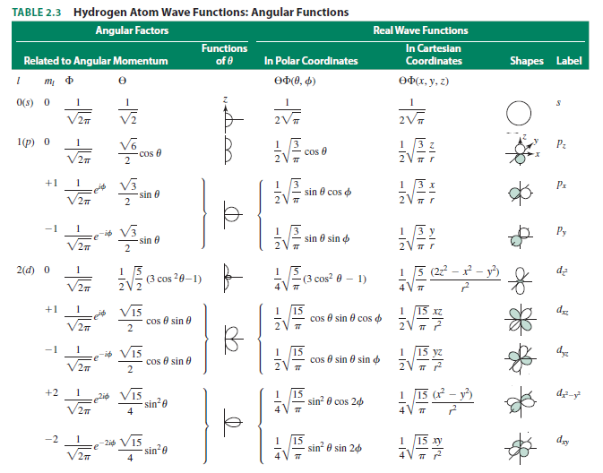

Slide 40
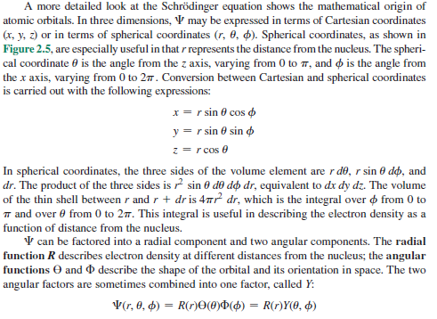

Slide 41
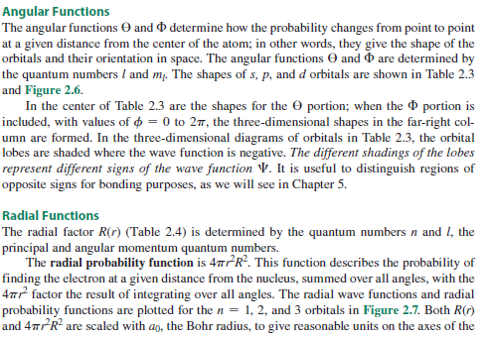
Separation of variables

Slide 42


Slide 43

1s
2s
Nucleus
Nucleus

Slide 44


Slide 45



Slide 46



Slide 47


Slide 48

Nucleus

Slide 49


Slide 50


Slide 51


Slide 52


Slide 53


Slide 54


Slide 55


Slide 56


Slide 57




Slide 58

Nodal intersection
Or Radial Distribution function

